Slide 1






A Longitudinal Analysis of Bloated Java Dependencies
César Soto Valero, Thomas Durieux, Benoit Baudry
Notes:
Hi everyone, I’m César from KTH Royal Institute of Technology in Sweden.
And today, I’m going to introduce you to our paper: “A Longitudinal Analysis of Bloated Java Dependencies”
We want to thank the reviewers and the PC chairs for choosing this work for an ACM distinguished Paper Award.

Slide 2
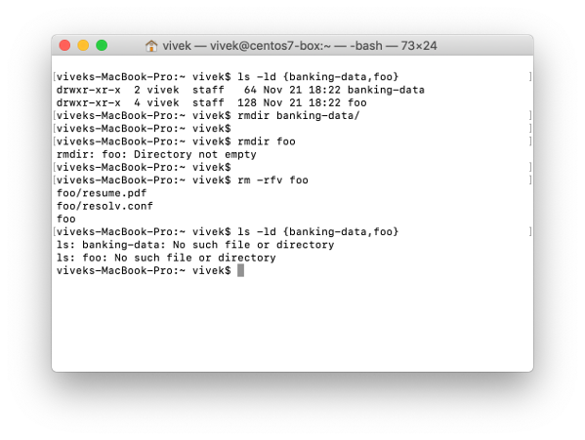


Software Bloat
Code that is packaged in an application but that is not necessary for building and running the application.
Maintenance
Security
Performance
Size
Notes:
The term software bloat refers to code that is packaged in an application, but that is not necessary for building and running it.
Empirical evidence shows that software is bloated, from single Unix commands to web browsers and operating systems.
Most applications embed a part of code that is unnecessary to their correct operation.
Software bloat is a problem because it needlessly wastes developers’ time and resources.
For example, software bloat increases the size of software artifacts, creates maintenance issues, affects performance, and compromises security.

Slide 3

Developers’ Question
Will this piece of bloated code be needed in the future?
Notes:
In the last years, research on software debloat has increased.
However, previous works have not analyzed the evolution of bloat over time.
In this context, understanding software bloat from the perspective of software evolution is crucial to promote debloating tools for software developers.
In particular, when proposed to use a debloating tool, developers wonder if a piece of bloated code might be needed in the coming releases of their project.
Our paper constitutes the first longitudinal analysis of software bloat.
In particular, we focus on the evolution of bloated dependencies in the Java/Maven ecosystem.

Slide 4
Bloated Dependencies Over Time
v₁
P
Time
Notes:
Let me show you an example of the evolution of bloated dependencies for a hypothetical project P.
We are going to visualize the dependency tree in different versions of this project.
In particular, we are interested in the usage status of its dependencies.
In the beginning, version 1 of project P has no dependencies.

Slide 5
Bloated Dependencies Over Time
v₁
v₂
P
P
pom.xml
<dependencies> <dependency> <groupId>org.A</groupId> <artifactId>A</artifactId> </dependency> <dependency> <groupId>org.B</groupId> <artifactId>B</artifactId> </dependency> </dependencies>
A
B
Time
Notes:
Then, when releasing version 2, developers decided to reuse some functionalities from two third-party dependencies: A and B.
To do so, developers just need to edit a particular file, called the POM file, in their Maven project.
This way, A and B become direct dependencies of project P.

Slide 6
Bloated Dependencies Over Time
v₁
v₂
P
v₃
P
P
A
B
A
B
C
D
Time
Notes:
Then, the third version of the project is released.
At this point, the developers of dependency A decide to augment its functionalities and declare two more dependencies: C and D.
These are now transitive dependencies of project P.

Slide 7
Bloated Dependencies Over Time
v₁
v₂
P
v₃
P
P
A
B
A
B
C
D
Time
Notes:
Suppose that developers of P don’t use the functionality of B anymore.
Then, this dependency is not used and becomes a bloated dependency of project P.

Slide 8
Bloated Dependencies Over Time
v₁
v₂
P
v₃
P
P
A
B
A
B
C
D
Time
Notes:
However, although unnecessary, developers keep this dependency in the POM of P.
For example, because they are not sure if the dependency will be necessary in the future.

Slide 9
Bloated Dependencies Over Time
v₁
v₂
P
v₃
P
v₄
P
P
A
B
A
B
A
B
C
D
C
D
Time
Notes:
As we can observe, the usage status of dependencies in the dependency tree of a project may change over time.
Our paper focuses on studying this phenomenon using empirical data.

Slide 10
Bloated Dependencies Over Time
v₁
v₂
P
v₃
P
v₄
P
P
A
B
A
B
A
B
C
D
C
D
Time
Notes:
In the subsequent version 4 of the project, dependency B remains bloated.
But now, the transitive dependency D is also bloated.

Slide 11
Bloated Dependencies Over Time
v₁
v₂
P
v₃
P
v₄
P
P
A
B
A
B
A
B
C
D
C
D
Time
Notes:
As we can observe, the usage status of dependencies in the dependency tree of a project may change over time.
Our paper focuses on studying this phenomenon using empirical data.

Slide 12
Research Questions
RQ1: How does the amount of bloated dependencies evolve across releases?
RQ2: Do bloated dependencies stay bloated across time?
RQ3: Do developers maintain dependencies that are bloated?
RQ4: What development practices change the usage status of dependencies?
Notes:
We articulated our work around four research questions:
Our first research question focuses on analyzing the evolution of the number of bloated dependencies.
Next, we investigate how the usage status of dependencies evolves across time.
This analysis is a key contribution of our work where we determine if a dependency that is bloated is likely to remain bloated over subsequent versions of a project.
Our third research question focuses on the unnecessary maintenance effort induced by bloated dependencies.
In particular, we investigate how often developers modify their POM files to update dependencies that are actually bloated.
In the last research question, we expand the quantitative analysis of the status of each dependency and perform an in-depth analysis of the causes of dependency bloat.

Slide 13
Research Questions
RQ1: How does the amount of bloated dependencies evolve across releases?
RQ2: Do bloated dependencies stay bloated across time?
RQ3: Do developers maintain dependencies that are bloated?
RQ4: What development practices change the usage status of dependencies?
Notes:
Due to the time constraints for this presentation, we are going to discuss the second and third research questions.
If you are interested in the rest, as well as in the details of our analysis, you are more than welcome to read our paper.

Slide 14




Data Collection Pipeline
Input
Collect
Filter
Analyse
Dataset
1
2
3
Collect single-module Maven projects
Filter commits that modify the POMs
Analyse the status of dependencies at each commit
435 projects
time
…
Java projects on GitHub
…
31,515 dependency trees analysed
over time
500 single-module Java Maven projects
Commits on the POM files
https://github.com/castor-software/depclean
https://github.com/castor-software/longitudinal-bloat
Notes:
The dataset used in our study consists of a collection of subsequent versions of Maven dependency trees.
Our data collection pipeline starts from the list of Java projects extracted from GitHub.
In the first step, we identify the Maven single-module project on GitHub.
We, then, select the 500 projects that have the most number of releases.
In the second step, we check all the commits made on the POM files.
Each time the version of the project changes, we consider that the commit represents a new release.
In the third step, we analyze the status of dependencies in the project at each commit.
We label each dependency as used or bloated.
Our final dataset consists of thirty one thousand five hundred and fifteen dependency trees from four hundred and fifteen projects.

Slide 15
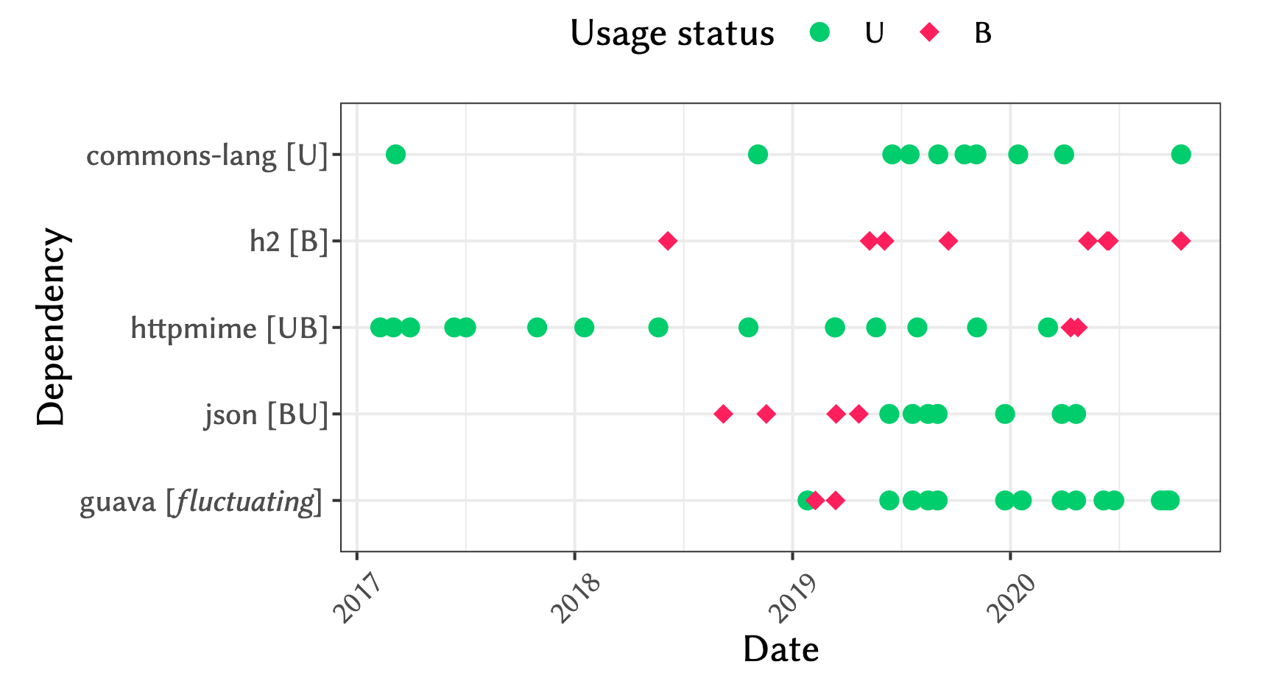






Research Question #2
RQ2: Do bloated dependencies stay bloated across time?
Notes:
To answer our second research question, we investigate how the usage status of dependencies changes over time.
The figure shows, in the x-axis, the sequence of usage statuses of four dependencies in our dataset: Apache commons-lang, h2, httpmime, json, and guava.
The y-axis represents the date when the dependency was analyzed.
Green dots mean that the dependency was used, red diamonds mean that the dependency was bloated.
We determine five transitional patterns.
U, when the dependency was always used.

Slide 16

Research Question #2
RQ2: Do bloated dependencies stay bloated across time?
Notes:
B when the dependency was always bloated.

Slide 17

Research Question #2
RQ2: Do bloated dependencies stay bloated across time?
Notes:
UB when the dependency was used and then bloated

Slide 18

Research Question #2
RQ2: Do bloated dependencies stay bloated across time?
Notes:
BU when the dependency was bloated and then used

Slide 19

Research Question #2
RQ2: Do bloated dependencies stay bloated across time?
Notes:
And fluctuating, in the cases where the usage status of a dependency flickers over time.

Slide 20
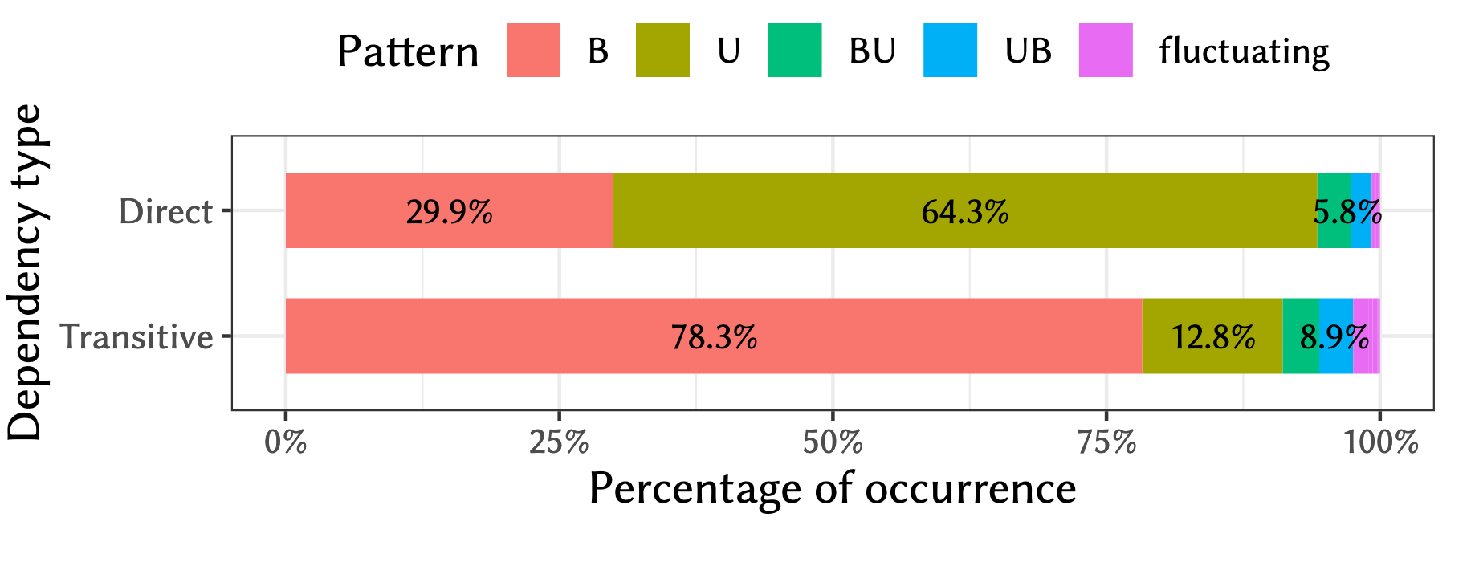
Research Question #2
RQ2: Do bloated dependencies stay bloated across time?
Notes:
We compute the percentage of occurrence of each pattern with respect to the total.
We found that 64.3% of the direct dependencies are always used in the projects, whereas 29.9% of them are always bloated.
This means that most direct dependencies never change their status through the evolution of the software projects.
On the other hand, 78.3% of the transitive dependencies are bloated from the start, whereas 12.8% are always used.
This means that transitive dependencies also do not change their usage status over time.

Slide 21
89.2% of bloated direct, and 93.3% of the transitive bloated dependencies remain bloated in all subsequent versions of the studied projects.
Research Question #2
Notes:
89.2 % of bloated direct, and 93.3 % of the transitive bloated dependencies remain bloated in all subsequent versions of the studied projects.
This empirical evidence suggests that developers can safely take a debloating action when detecting bloated dependencies.

Slide 22

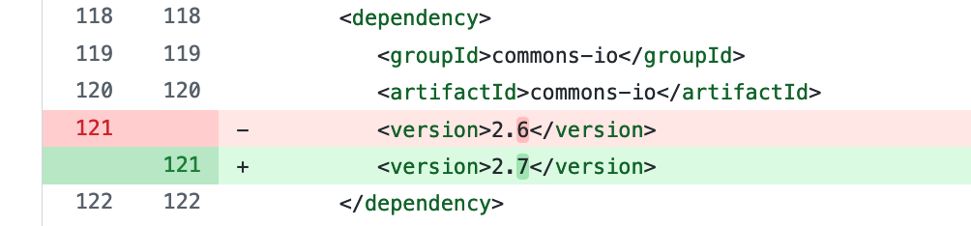
Research Question #3
RQ3: Do developers maintain dependencies that are bloated?
Notes:
To answer our third research question, we investigate whether or not developers maintain dependencies that are bloated.
We filter all the commits in our dataset that constitute dependency updates.
The figure shows an example of one of such commits.
In this case, a developer manually updates the dependency of Apache commons-io from version 2.6 to version 2.7.

Slide 23


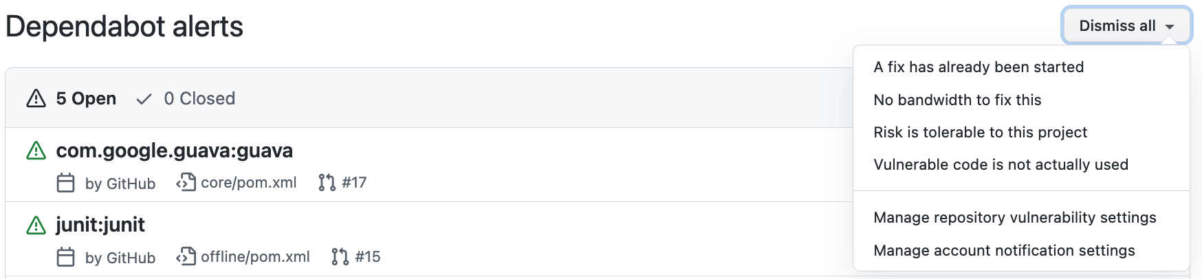
Research Question #3
RQ3: Do developers maintain dependencies that are bloated?
Notes:
During our analysis, we notice that many of the dependency updates were performed by Dependabot.
This is a software bot very active on GitHub that alerts developers about security issues related to their dependencies.

Slide 24
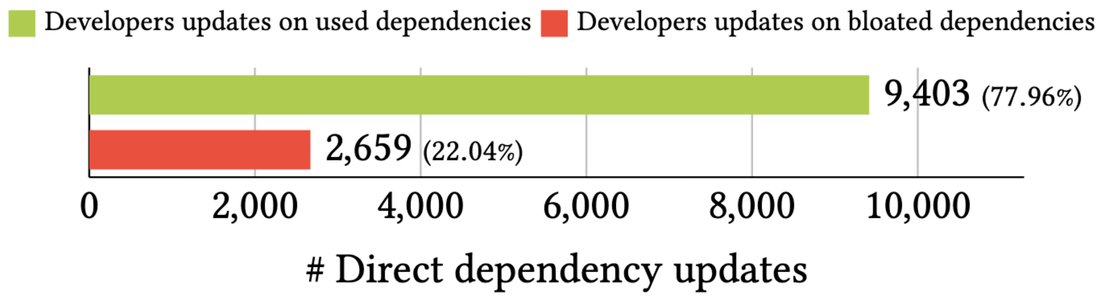
Research Question #3
RQ3: Do developers maintain dependencies that are bloated?
Notes:
This plot presents the number of dependency updates on used and bloated dependencies made by developers.
As we can see, developers invest 22% of their dependency update efforts on bloated dependencies.

Slide 25
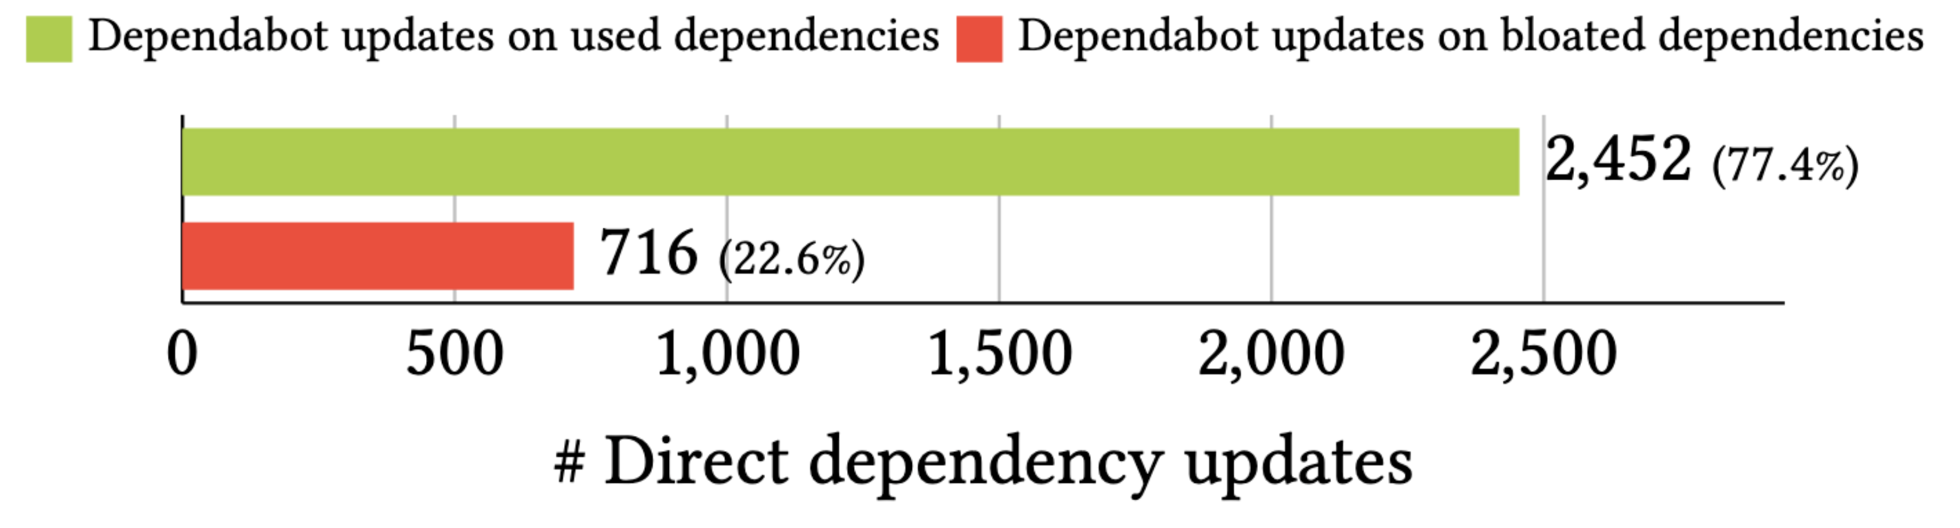
Research Question #3
RQ3: Do developers maintain dependencies that are bloated?
Notes:
On the other hand, we observe that Dependabot suggests a similar ratio of updates on bloated dependencies.
This result indicates that Dependabot should improve the suggestions that it makes to developers to detect bloated dependencies and reduce the maintenance effort induced by software bloat.

Slide 26
22% of dependency updates performed by developers and bots are made on bloated dependencies, which is a waste of maintenance effort that can be minimized by removing these dependencies.
Research Question #3
Notes:
So, the 22% of dependency updates performed by developers and bots are made on bloated dependencies.
This is evidence that software bloat artificially increases the maintenance effort of software projects.
This effort can be minimized by removing bloated dependencies, which is safe because, as we found in the previous research question, bloated dependencies are very likely to remain bloated in the future.

Slide 27
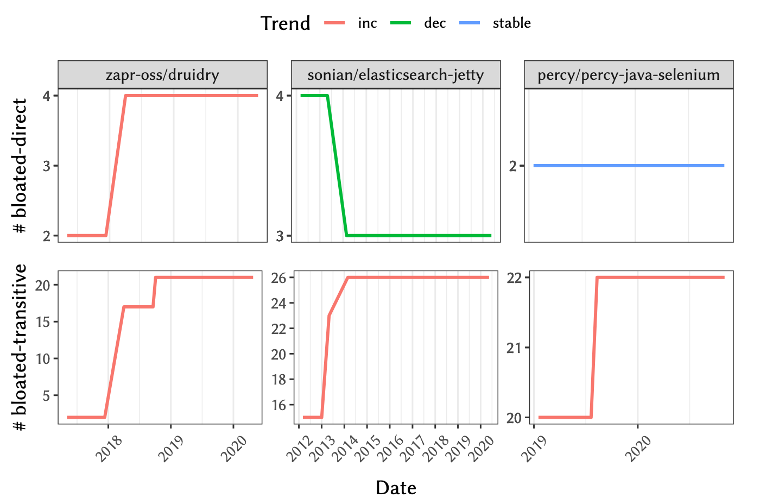
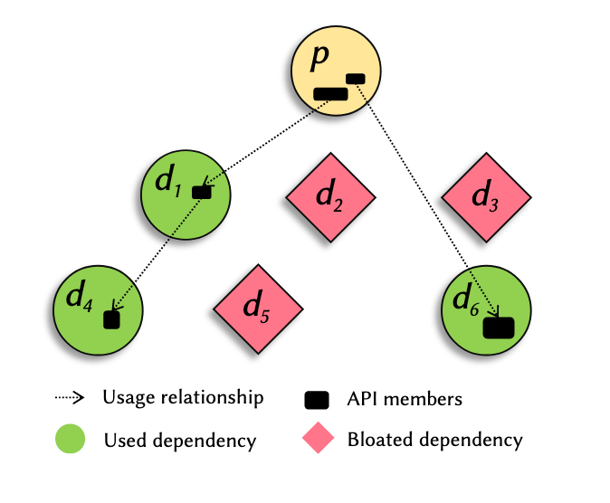
Most bloated dependencies remain bloated
Bloated dependencies introduce significant maintenance overhead
Notes:
We invite you to read our paper for more details on this work, and feel free to contac us if you have questions or comments.
Thank you very much for watching.

